Slide 1
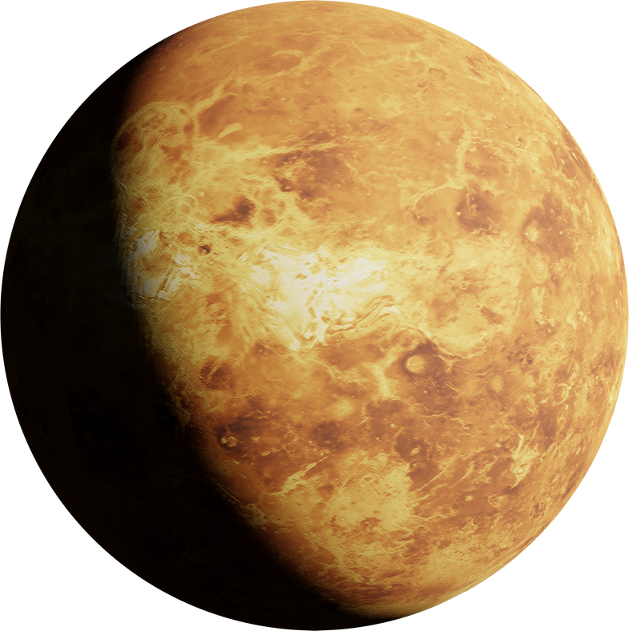
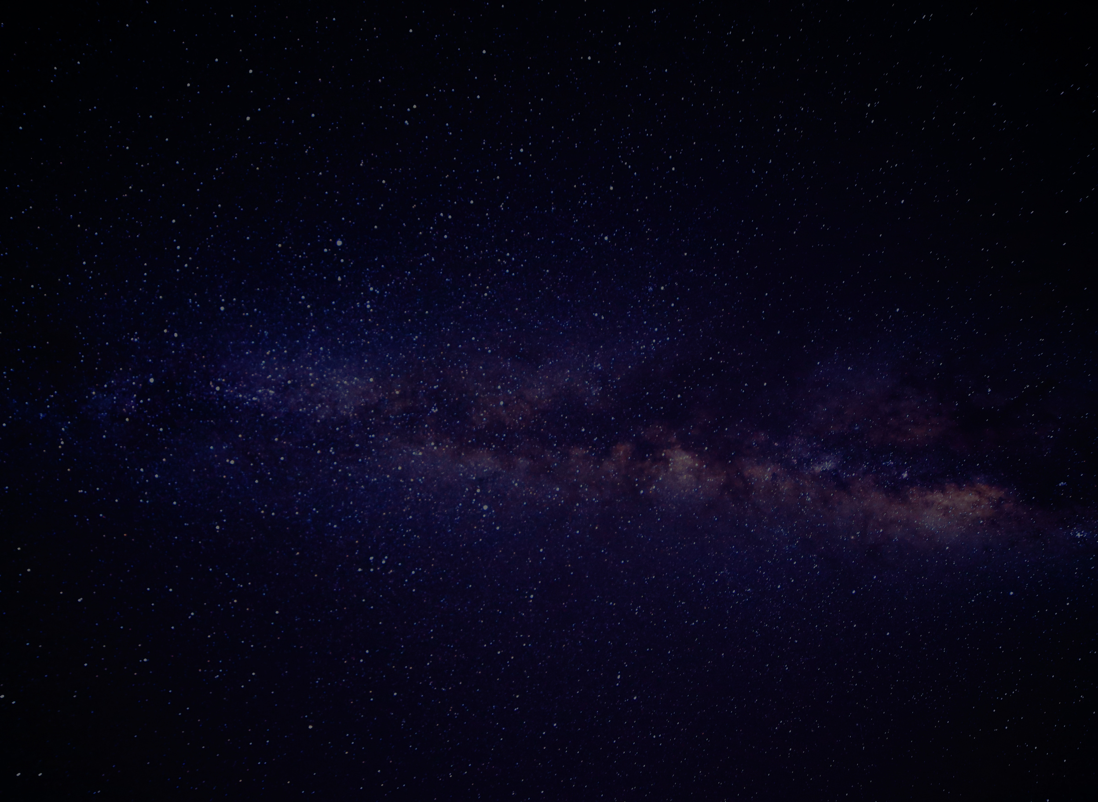

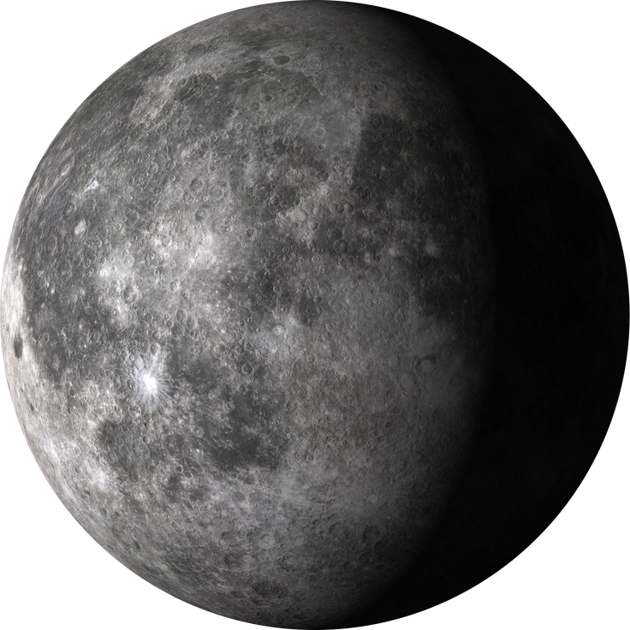
ECLIPSE TRIVIA
PRESENTED BY:
SALONI TRIVEDI
KHUSHBUNAZ DALAL
MAHEK PARMAR

Slide 2
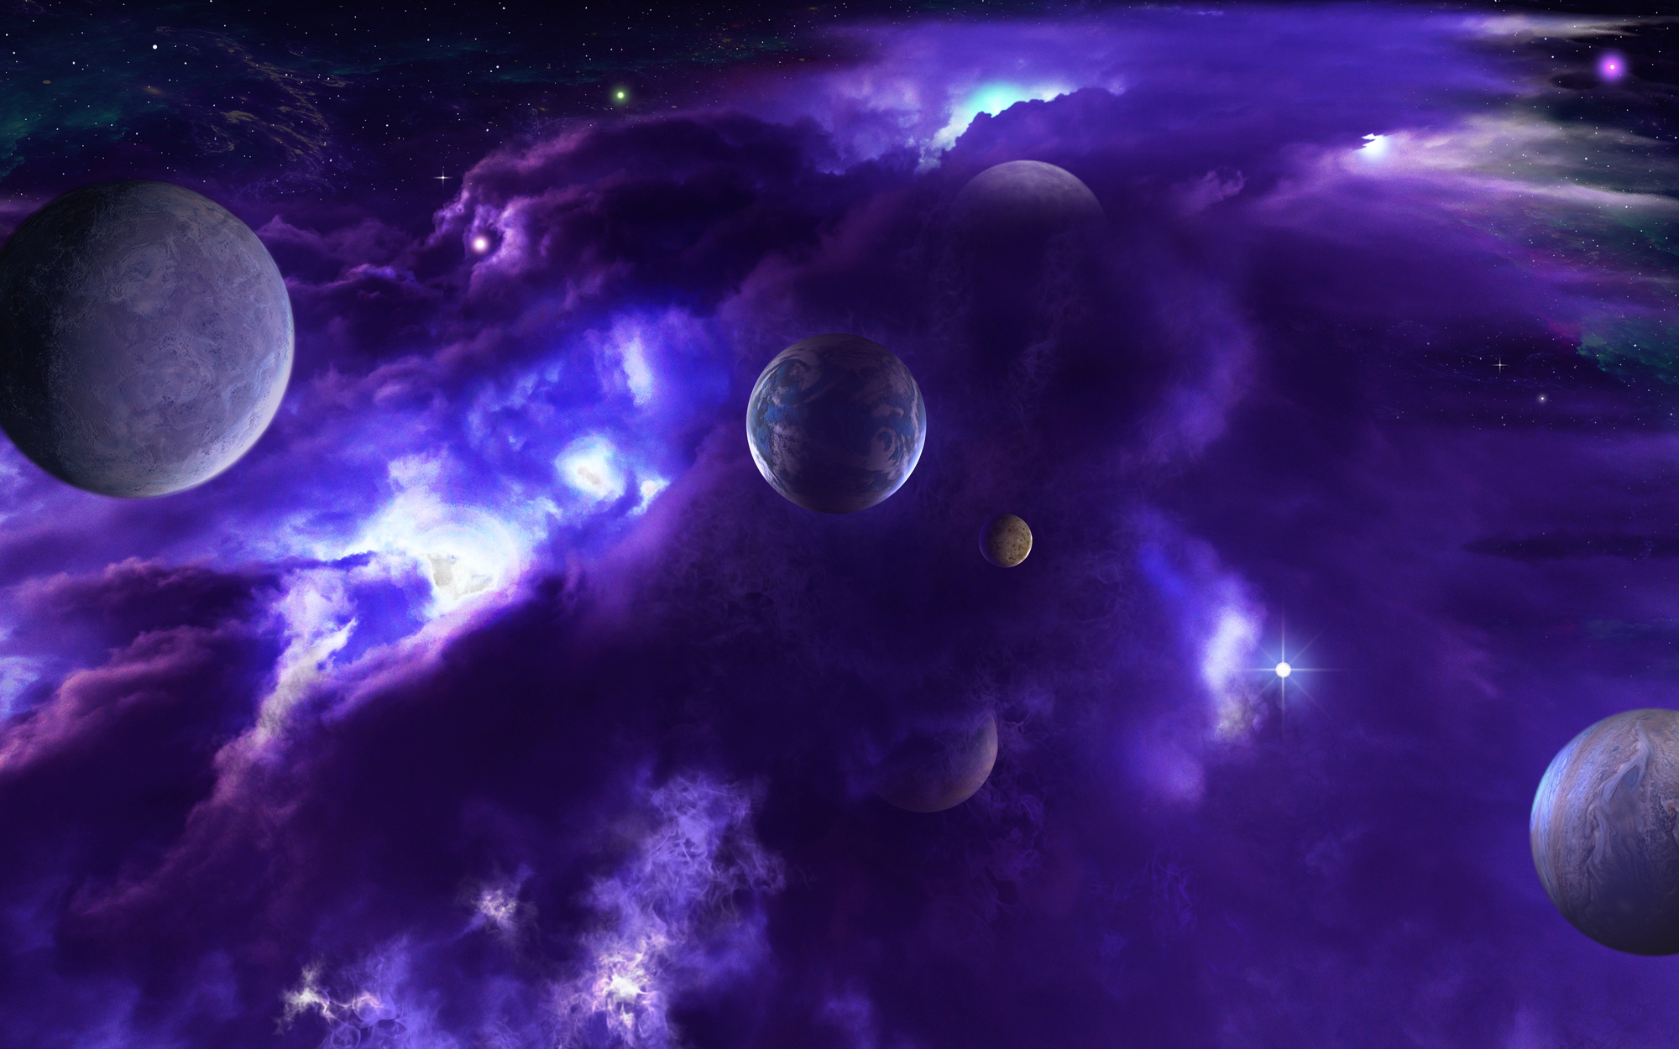
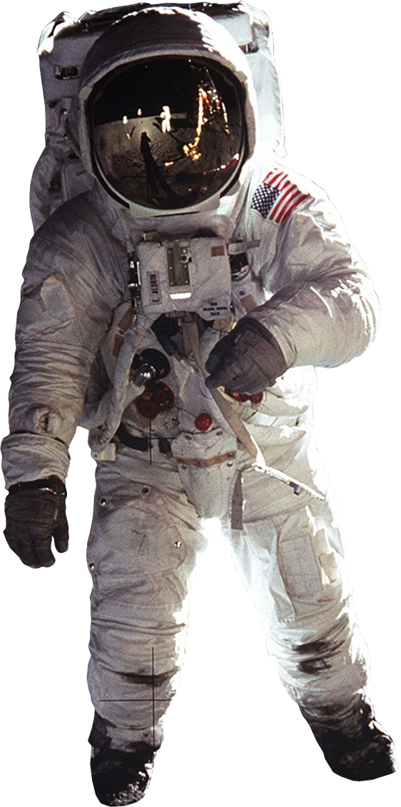
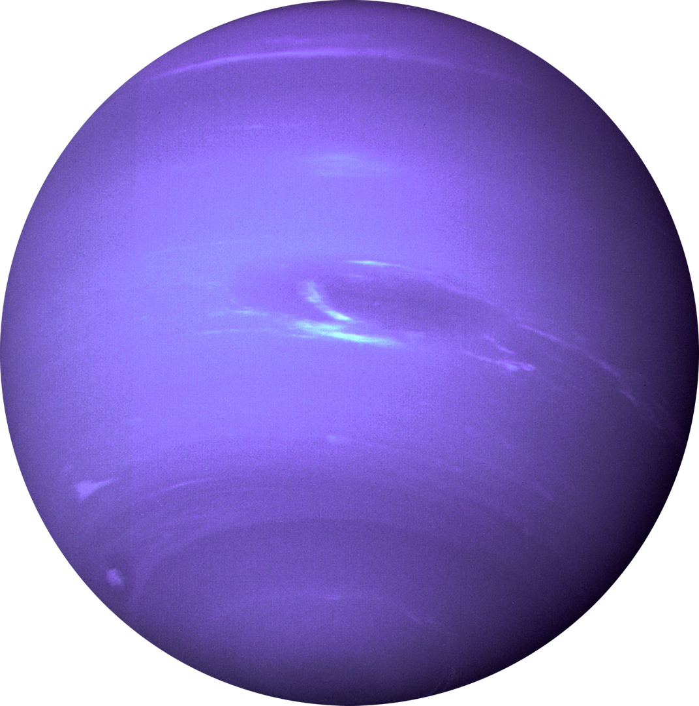
WHAT ARE ECLIPSE?
An eclipse is a fascinating event when one celestial object passes in front of another, temporarily blocking its view from our perspective.

Slide 3
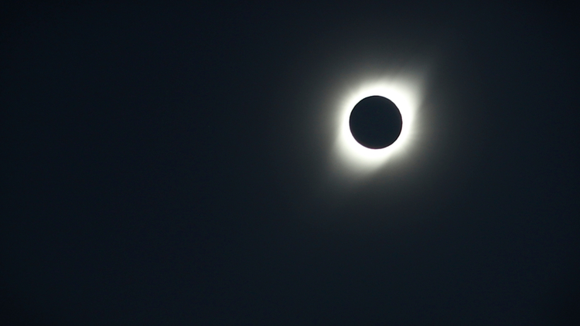
ECLIPSE SEASONS
Eclipses do not happen randomly but follow specific patterns.
Eclipse seasons are times when the Sun, Earth, and the Moon align in a way that allows eclipses to occur.

Slide 4
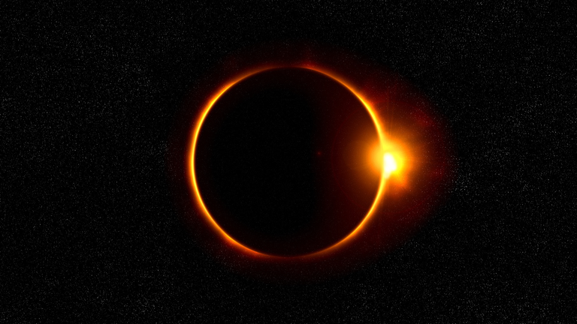
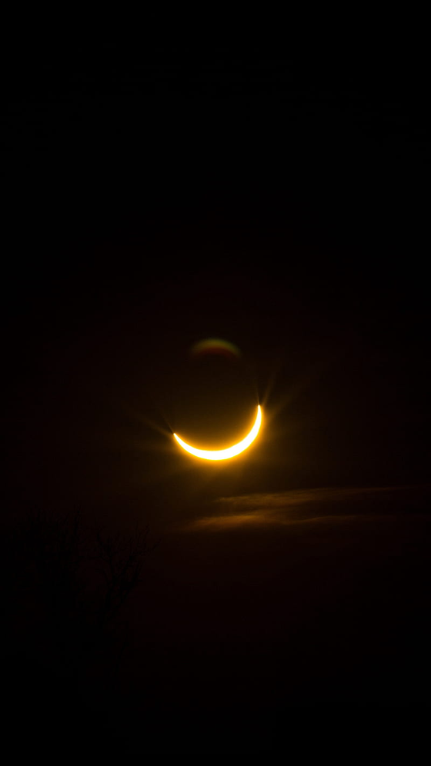
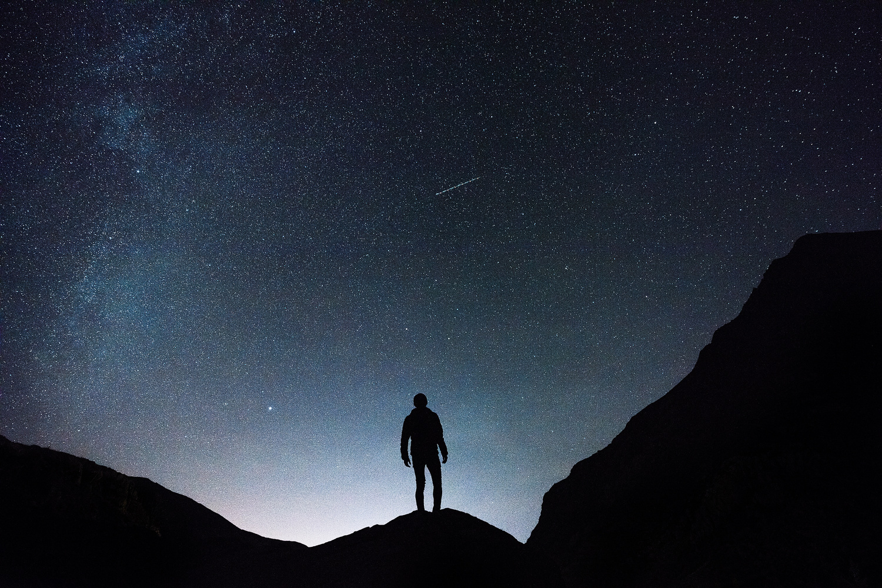
SOLAR AND LUNAR ECLIPSE
Solar Eclipse: "Occurs when the Moon comes between the Earth and the Sun, blocking the Sun's light."
Lunar Eclipse: "Happens when the Earth comes between the Sun and the Moon, casting a shadow on the Moon."

Slide 5
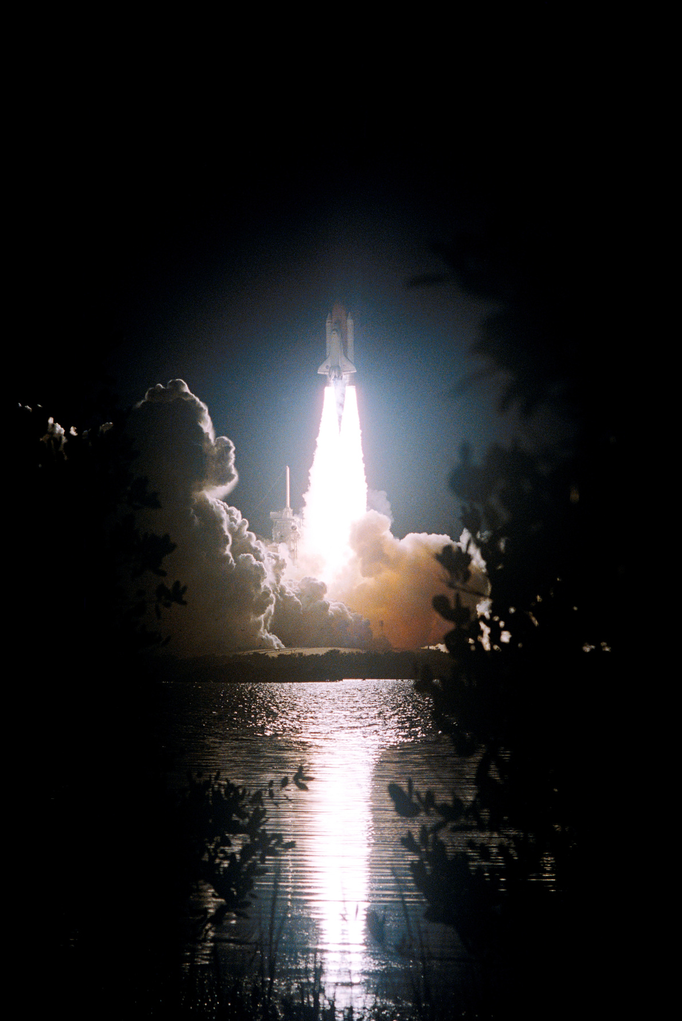
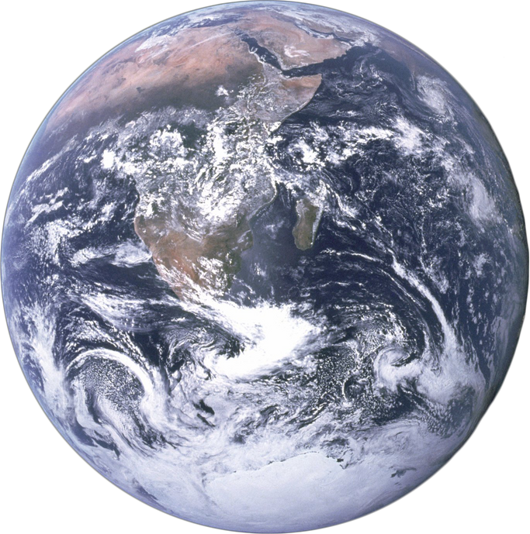
ECLIPSE ADVENTURE GAME
The Eclipse Trivia Game is an interactive Python application that combines space-themed graphics, trivia questions, and user interaction.
Players are presented with a series of eclipse-related questions, each with multiple-choice answers.
The game features an engaging space background and allows players to select answers using mouse clicks. For each correct answer, the player's score increases.
The game continues until all questions have been answered, offering an educational and entertaining experience about eclipses.

Slide 6

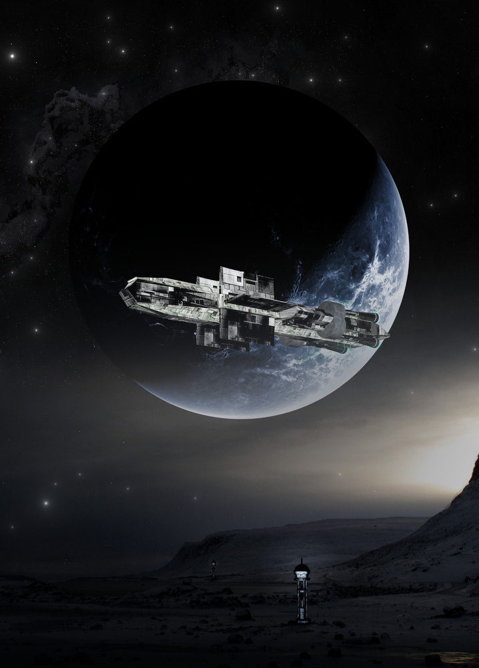

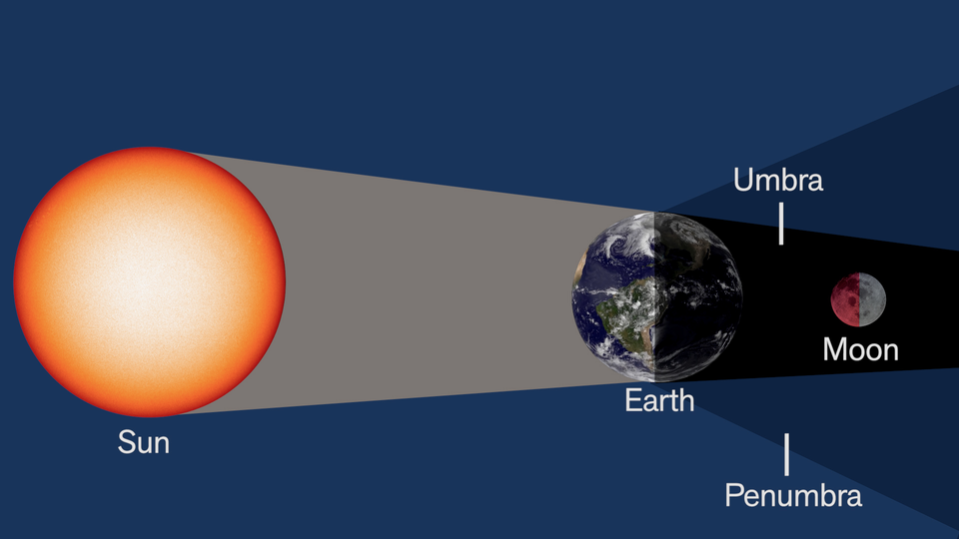
APPLICATIONS
Educational Tool
Public Outreach
Online Learning Platforms
Entertainment
Trivia Nights
Educational Websites
STEM Workshops
School Competitions.
Casual Learning

Slide 7

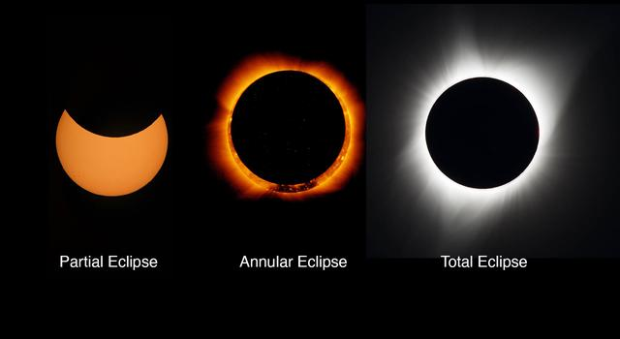
THANK YOU
FOR YOUR ATTENTION

